Slide 1


Slide 2




Advanced Placement Results from SY 2024-2025
Gerald Fitzhugh, II, Ed.D.
Superintendent of Schools
“ The Teaching Superintendent”
August 13, 2025
Focus Core Area Numbers 1- 4 District Goal Number 1-4 and All

Slide 3



Orange High School
Five-Year Summary

Slide 4


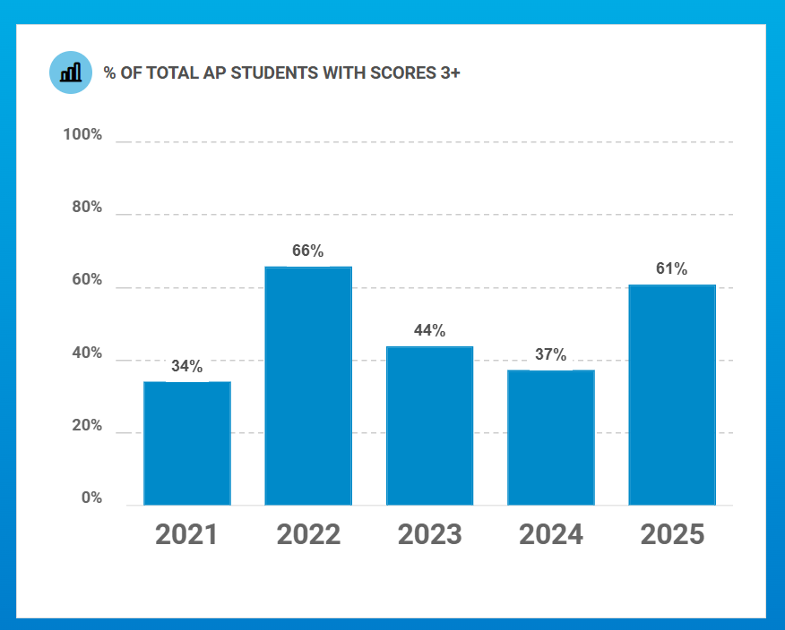


Slide 5
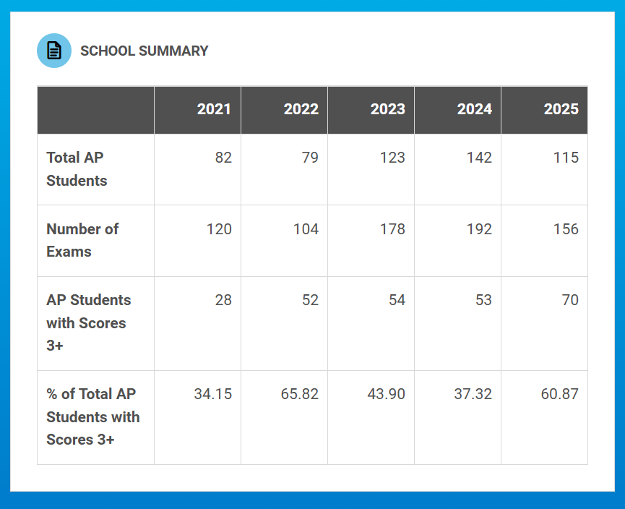

Slide 6

Stem Innovation Academy of the Oranges
Five-Year Summary

Slide 7
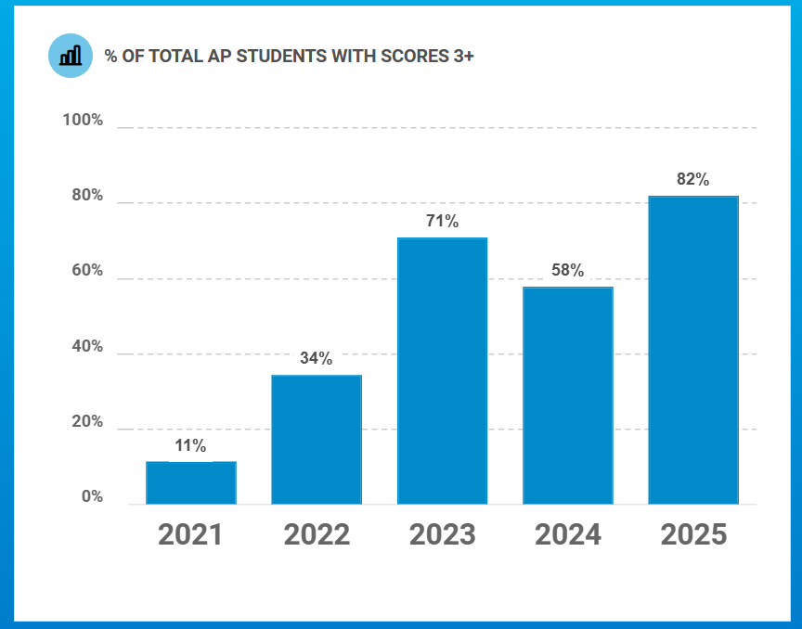

Slide 8
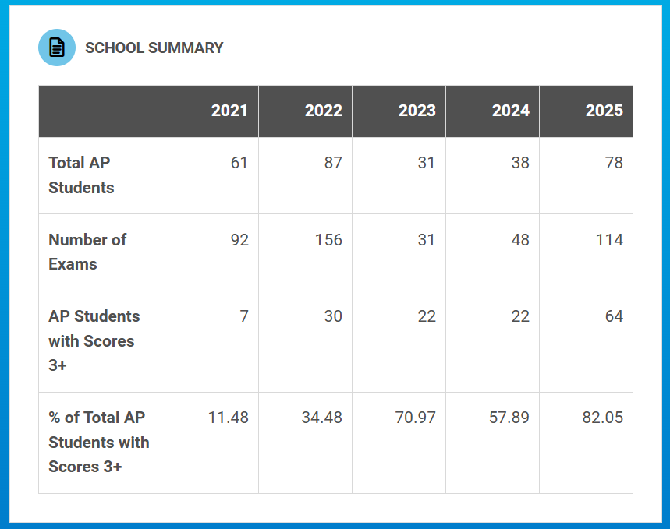

Slide 9
ACCESS Data for 3 years
Where we were, where we are, where will we be?
Karen Harris
Executive Director; Office of Humanities
August 13, 2025

Slide 10
ACCESS SY’ 2022-2023 -
[43 Exited]
Grade |  | 1 Entering | 2 Emerging | 3 Developing | 4 Expanding | 4 Expanding E | 5 Bridging | Grand Total
0 |  | 110 | 28 | 13 | 9 | 8 | 2 | 170
1 | 1 | 55 | 50 | 32 |  |  |  | 138
2 | 1 | 40 | 50 | 29 | 2 | 1 |  | 123
3 |  | 26 | 38 | 34 | 7 | 2 | 2 | 109
4 | 1 | 29 | 23 | 49 | 25 | 7 | 3 | 137
5 | 1 | 25 | 13 | 18 | 11 | 7 | 6 | 81
6 |  | 23 | 16 | 19 | 5 | 1 |  | 64
7 | 1 | 30 | 22 | 8 | 1 |  |  | 62
8 | 1 | 32 | 15 | 11 | 6 |  |  | 65
9 | 1 | 21 | 19 | 8 | 1 |  |  | 50
10 | 2 | 50 | 17 | 20 |  | 2 |  | 91
11 |  | 44 | 29 | 13 | 3 |  |  | 89
12 |  | 29 | 16 | 6 |  | 2 |  | 53
Grand Total | 9 | 514 | 336 | 260 | 70 | 30 | 13 | 1232

Slide 11
ACCESS SY’2023-2024 - [59 Exited]
Grade |  | 1 Entering | 2 Emerging | 3 Developing | 4 Expanding | 4 Expanding E | 5 Bridging | Grand Total
0 | 1 | 120 | 24 | 11 | 2 | 3 | 1 | 162
1 | 6 | 91 | 49 | 35 | 2 | 2 | 1 | 186
2 |  | 49 | 40 | 49 | 5 |  |  | 143
3 | 3 | 49 | 48 | 33 | 5 | 4 |  | 142
4 | 1 | 26 | 24 | 39 | 19 | 9 | 6 | 124
5 |  | 31 | 27 | 40 | 24 | 16 | 4 | 142
6 |  | 22 | 23 | 35 | 7 | 1 |  | 88
7 |  | 34 | 17 | 26 | 6 | 3 | 1 | 87
8 |  | 26 | 24 | 18 | 9 |  | 1 | 78
9 |  | 29 | 40 | 27 | 6 | 3 | 1 | 106
10 |  | 35 | 22 | 14 | 2 | 1 |  | 74
11 | 1 | 39 | 15 | 24 | 2 |  |  | 81
12 |  | 39 | 23 | 11 | 2 | 2 |  | 77
Grand Total | 12 | 590 | 376 | 362 | 91 | 44 | 15 | 1490

Slide 12
ACCESS SY’2024-2025 - [68 Exited]
Grade |  | 1 Entering | 2 Emerging | 3 Developing | 4 Expanding | 4.5 Expanding E | 5 Bridging E | 6 Reaching E | Grand Total
0 |  | 105 | 30 | 23 | 9 | 4 | 1 |  | 172
1 | 3 | 69 | 53 | 25 | 7 |  |  |  | 157
2 | 2 | 55 | 59 | 51 | 9 | 1 |  |  | 177
3 |  | 25 | 38 | 57 | 15 | 1 |  |  | 136
4 |  | 19 | 28 | 53 | 17 | 12 | 3 | 1 | 133
5 |  | 18 | 24 | 23 | 18 | 5 | 13 | 1 | 102
6 |  | 16 | 35 | 45 | 14 | 5 |  |  | 115
7 |  | 17 | 24 | 35 | 14 | 5 |  |  | 95
8 |  | 18 | 19 | 25 | 7 | 6 | 1 |  | 76
9 |  | 24 | 29 | 31 | 5 | 1 | 1 |  | 91
10 |  | 23 | 31 | 25 | 8 | 1 |  | 1 | 89
11 |  | 37 | 13 | 19 | 3 | 2 | 2 |  | 76
12 | 1 | 38 | 14 | 19 | 6 | 1 |  |  | 79
Grand Total | 6 | 464 | 397 | 431 | 132 | 44 | 21 | 3 | 1498
Notes:
1562 total students currently in program during 2025
374 in program less than a year
196 students left the district in 2024-2025
36.4% mobility rate

Slide 13
Key Points
1562 total students currently in program during 2025
374 in program less than a year
196 students left the district in 2024-2025
36.4% mobility rate
What does this mean?
  We must be steadfast in providing systematic systemic support in English across the curricula
  Provide scaffolds to understanding in native language when possible
  Monitor progress and move students through different phases of the program when milestones are achieved

Slide 14





Orange Public Schools
Fully Staffed Classrooms:
A Non-Negotiable for Student Success
Gerald Fitzhugh, II, Ed.D
Superintendent of Schools
Nancy Masoud
Executive Director of Human Resources

Slide 15
Fully Staffed Classrooms:
A Non-Negotiable for Student Success
"Every child deserves a prepared teacher in front of them on day one."
Why It Matters
Impact on Students
A fully staffed classroom ensures continuity of learning from the very first bell.
Students build relationships and trust with their teacher early, setting the tone for the year.
Academic Growth: Students engage in consistent, high-quality instruction without delays.
Social-Emotional Wellbeing: Stability in the classroom fosters belonging and reduces anxiety.
Impact on Staff & School Culture
Our Commitment in Orange Public Schools
Reduces the strain on existing staff who might otherwise cover vacancies.
Supports a positive school climate by ensuring smooth operations from day one.
Proactive Recruitment: Hiring begins early to secure the best talent.
Retention Strategies: Competitive benefits, mentorship programs, and professional growth.

Slide 16




Orange Public Schools
Instructional Vacancies
2022-2024
Opening of the 2022-23 School Year
Opening of the 2023-24 School Year
Opening of the 2024-25 School Year
47
44
64

Slide 17

Orange Public Schools
9
Instructional Vacancies
2025-2026 School Year

Slide 18

Orange Public Schools
District Goals 2025–2026

Slide 19
District Goals 2025–2026
Goal
Goal #1: 21st Century Integration
Goal
Goal #2: Community Engagement
Goal
Goal #3: Facilities, Finance, and Staff Support
Goal
Goal #4: Social and Emotional Supports

Slide 20
Goal #1: 21st Century Integration
The Orange Public Schools will continue to invest in its great instructional staff. The district values and promotes a culture of excellence in teaching and learning through increased and improved opportunities for quality, sustained professional development that address district needs and individual school needs as outlined by data points. The emphasis has been and will continue to be on best practices in teaching and learning. A continued understanding of providing targeted and intentional delivery of instruction is paramount district-wide while keeping in mind how to integrate technology; to strengthen but not decline instructional practices.

Slide 21
Goal #1: 21st Century Integration
Increase in the number of job-embedded professional learning opportunities that incorporate the expertise of building principals planning alongside district administration by 75% from SY 24-25
  Administrative Meetings will continue to be instructionally-focused learning sessions for principals and district administrators. Ultimately, all training sessions will be germane to data points resulting from walk-through trend analyses.
  Administrative meetings will continue to have instructionally focused agendas with accompanying sign in sheets. Meetings will take place for horizontal and vertical articulation supports to build content knowledge and pedagogy if applicable and integration of technology to enhance the current curricula through structured Teacher Enrichment Success Periods district-wide.

Slide 22
Goal #1: 21st Century Integration
2) By May 2026, 60% of students in each preparedness group will meet or exceed their assigned end of year growth target in mathematics.
  The assessments that will be used to measure progress towards the assigned growth targets include the iReady Diagnostic. NWEA MAP, District Benchmark Assessments, and select Performance Tasks in the area of Mathematics.
  The district will continue to report out all data in the area of mathematics in Curriculum Committee as per the assessment calendar as well as the Board of Education Meeting.

Slide 23
Goal #1: 21st Century Integration
3) By May 2026, 60% of students in each preparedness group will meet or exceed their assigned end of year growth target in ELA.
  The assessments that will be used to measure progress towards the assigned growth targets include Reading Diagnostics, District Benchmarks, and Performance Tasks in the area of English Language Arts.
  The district will continue to report out all data in the area of English Language Arts in Curriculum Committee as per the assessment calendar as well as the Board of Education Meeting.

Slide 24
Goal #1: 21st Century Integration
4) By May 2026, 60% of students in each preparedness group will meet or exceed their assigned end of year growth target in Science.
  The assessments that will be used to measure progress towards the assigned growth targets include benchmark assessments in the area of Science.
  The district will continue to report out all data in the area of Science in Curriculum Committee as per the assessment calendar as well as the Board of Education Meeting.

Slide 25
Goal #1: 21st Century Integration
5) By June 2026, 5% increases across all areas on the New Jersey Student Learning Assessment (Mathematics, Science, and English Language Arts)
  The assessments that will be used to measure progress towards the assigned growth targets include Reading Diagnostics, District Benchmarks, and Performance Tasks in the area of English Language Arts.
  The district will continue to report out all data in the area of English Language Arts in Curriculum Committee as per the assessment calendar as well as the Board of Education Meeting.

Slide 26
Goal #1: 21st Century Integration
6) By June 2026, 100% of students will continue to have access to meaningful experiences of powerful learning opportunities and will demonstrate competencies and skills for the digital age.
  All students will continue to receive dedicated devices (Chromebooks) and accessories for year-round access in and out of school
  The district will continue to strengthen its device management plan to address repairs of accidental damage and provide extended warranties
  The district will ensure processes and protocols at the school level are followed to replace lost, damaged, or stolen devices. This will include device management and inventory systems.
  The district will continue support of full-time, school-based Technology Coordinators and VILS Coaches to help build educator capacity districtwide in the integration of technology across all subjects
  Schools will continue to cultivate student tech teams to involve students directly in the planning, execution, and day-to-day management of implementation
  The district will continue to incorporate a 3-tiered system of assessing the degree of technology integration across the schools to include Technology Integration Matrix Lesson Observation Tool (TIM-O) walk throughs, Fall/Winter/Spring teacher/student surveys, and Usage Inventories (Time and Data).

Slide 27

Goal #2: Community Engagement
1) The Orange Public Schools will continue a system of consistent communication system for disseminating and receiving information between school administration, teachers, staff, students, parents, and the community.
  Increase the timeliness, access, and effectiveness of all communication with all stakeholders via multiple measures by 60% from the previous school year
  Social Media Platforms & Website (Instagram, Facebook, and X formally know as Twitter)-Utilize the platforms for immediate news-worthy information as well as the district website via the latest news and announcements section.
  RoboCalls via School Wires at the district and school levels; we are incorporating more text to speech and emails for as well as translated versions of all messages both district and at the school level.
  Superintendent’s Report (online access to staff and community stakeholders) the day immediately following the board meeting by noon.
  Routine face-to-face opportunities to engage with community and stakeholders via PTO, Back to School Nights, Report Card Conference Nights, Community Events within Orange Township as well as partnership meetings based on those established and forthcoming within the school district. We will continue the parent and student councils at the Superintendent’s Level.
  Provide Bilingual Supports for all families to ensure their engagement within the school district via translations, translator supports, and district as well as social level meetings.

Slide 28
Goal #2: Community Engagement
2) Increase the use of emerging and available communications outlets to transmit information by 50% (Last Year the Percentage was at 45%)
  Partner with universities (local and throughout the state) in order to get information to prospective candidates for job fairs and other industry level announcements. We will conduct virtual and in person job fairs as well to widen the search for potential candidates outside of the University realm.
  Continue to utilize the Orange Public School App for more timeless information.
  Continue to utilize the Emergency Pop Up on the website for transmitting important, time sensitive information weekly.
  Provide Translations on all documents that are disseminated from schools and district offices.
  Create an updated website that is easier to navigate with fidelity (Parent Square Implementation and Completion)
  Utilize class intercom as a vehicle to get messaging out to families and staff via the social media lens.

Slide 29
Goal #2: Community Engagement
3) Continue Parent and Student Councils at the Superintendent’s Level
  Have monthly meetings with parents and students about academics as well as self-care supports; student council meetings will take place separately from the parent council.
  Continue the Bilingual Parent Advisory and ensure that the meetings are quarterly.
  Continue the Special Education Advisory Council Meetings and ensure that the meetings take place quarterly.
  Continue the Early Childhood Advisory Council Meetings and ensure that the meetings take place quarterly.
  Continue the Nutrition Advisory Council alongside school level student councils. Ensure that the meetings take place quarterly.

Slide 30
Goal #3: Facilities, Finance, and Staff Support
THE ORANGE PUBLIC SCHOOLS WILL CONTINUE TO PLACE AN IMPORTANCE ON THE FISCAL MANAGEMENT, OPERATIONS, AND HUMAN RESOURCES OF THE ORGANIZATION TO ENSURE A SYSTEM OF ACCOUNTABILITY, TRANSPARENCY, AND EFFICIENCY FOR THE OPTIMAL DELIVERY OF SERVICES FOR PARTNERSHIPS TO FLOURISH AND STAFF TO BE RETAINED ACROSS THE DISTRICT.
1) Create a district budget under constraints that accommodates and supports the needs of central office departments, all schools and students while sustaining systems that have yielded results through a strategic assessment of data
  Analyze and clarify how all budgeted funds are allocated and expended at the department and school levels.
  Examine and evaluate contracted services provided to the district and continuously improve effectiveness.
  Identify and execute capital projects (short term/long term, prioritized, and categorized on the basis of need.)
  Transfers from account lines on the district level will decrease by 30% from the previous school year (25% was the percentage given for SY 24-25)

Slide 31
Goal #3: Facilities, Finance, and Staff Support
2) Implement innovations that empower teaching and learning as well as efficiently allocate funding within their locations Analyze and clarify how all budgeted funds are allocated and expended at the department and school levels.
  Continue to monitor the budgeting module My Budget File to ensure adherence to staff and federal mandates.
  Align the long-term and short-term facilities development plan to outfit buildings district wide in the effort of expanding programming throughout the school district. These plans will be presented at the Facilities and Finance Committee Meetings as well as via the Regular Board of Education Meeting as we have several aging buildings in the district.
  Ensure equitable staffing distribution across all schools to address student needs and maintain compliance with class size and scheduling guidelines.

Slide 32
Goal #3: Facilities, Finance, and Staff Support
3) Maximize employee expertise and create a positive and supportive environment
  Conduct structured feedback sessions with staff to assess workplace satisfaction and identify areas for improvement.
  Continue to offer the Employee Assistance Program to allow for continued support of our staff holistically.
  District level personnel attend meetings at the school level in order to bridge the gap between the schools and district office.
  Visitations by the Superintendent’s Executive Team to check in with all employees quarterly as a part of taking a pulse on the climate and culture of the Orange School District.
  Expand professional development opportunities for all staff, including leadership pathways and mentorship programs to improve retention and growth.
  Enhance recruitment strategies to attract and retain high-quality educators and support staff, ensuring alignment with district needs and goals.

Slide 33
Goal #4: Social and Emotional Supports
The Orange Public Schools will continue to ensure that all students will receive social and emotional support to become adaptable, confident citizens who embody self-awareness and strong interpersonal skills, and who are capable of responsible decision-making and managing their emotions and behaviors.
1) Provide research-based curriculum to strengthen students’ social/emotional relationships
  Continue to utilize Restorative Practices as a means of providing effective support to students in the effort of problem solving. This includes at both the elementary and secondary levels.
  Continue the monitoring of mental health to provide students with another avenue to combat social-emotional concerns and thus remediate areas of deficiency related to mental health.
  Ensure that staff and students continue to have resources readily available by the district to ensure their social-emotional needs are met with fidelity.
  Ensure that we provide resources through the Superintendent’s Trauma informed team in the effort of providing supports for students across the district.
  Provide additional supports and instruction in wellness and make sure that students have access in the development of oneself.

Slide 34
Goal #4: Social and Emotional Supports
2) Enhance community-based partnerships in order to assist students and families
  Continue to utilize the district’s community engagement officer as well as community school liaisons to assist school-based staff with establishing partnerships to support families and students and thus have a vehicle to support families Pre-K through Twelve.
  Provide self-care support for students and families based on surveys (conducted twice per year) as well as discussion with support staff members including the Superintendent’s Trauma Informed Team.

Slide 35


FINAL SCHOLARSHIP UPDATE
Each month, Supervisor of Guidance, Mrs. Williams-Ware, provides our Superintendent with scholarship totals. Ok, so here we go:
Orange High School as of August 11, 2025, has amassed: $14,832,900.00
STEM Innovation Academy of the Oranges as of August 11, 2025, has amassed: $15,226,382.00
Total: $30,059,282.00
We are so very proud of our scholars. Thank you to our fantastic staff at Orange High School and STEM Academy for working so closely with our scholars to ensure that they have the opportunities to amass millions of dollars in scholarships.
The goal post for SY 25-26 is 32,000,000.00….

Slide 36
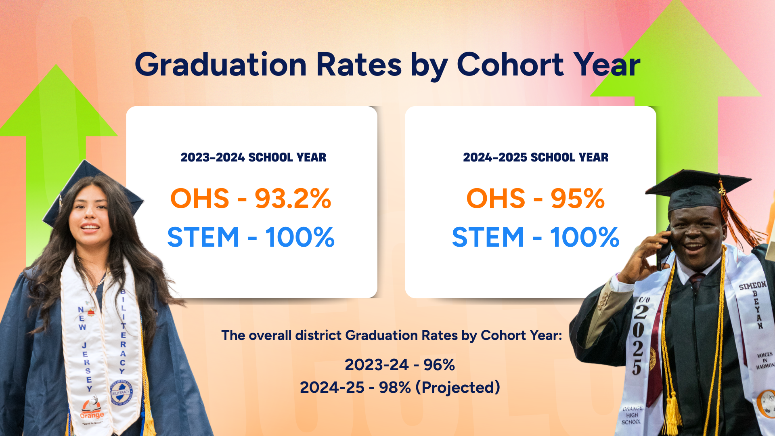

Slide 37
Grades 6-8 Open Sci Ed
Curricular Resource via Kendall Hunt Publishing
David Scutari
Executive Director, Office of STEM-Focused Learning
August 13, 2025

Slide 38
Why now?
Review of current curricular resources as well as science student achievement data
Selecting curricular resources and implementing a new curriculum is an opportunity to foster cohesion, trust, and professional learning, as well as to assess and respond to interests and needs (Joshua Starr, To Improve the Curriculum, engage the whole system)

Slide 39
What was the Process?
RFP issued in May 2025
Sub-committee convened to review submissions using guidelines outlined in RFP and select top 2 vendors
Top 2 vendors invited to present and unpack the curricular resources to full committee.
(Savvas Learning Company and Kendall Hunt Publishing Open Sci Ed)
Committee convened for instruction on use of the EQuIP Rubric for Science
The committee probed each vendor’s materials during in depth Q&A session
Committee members completed assigned sections of EQuIP Rubric for Science
Open dialogue amongst committee members
The committee’s findings presented to Superintendent

Slide 40
Who was on the committee?
Representation from across title, grade level, and servicing of student sub-group
  7 Teachers who service grades 6-8
  4 Teacher Coaches
    3 Science, 1 Special Education
  4 Administrators
    1 Executive Director
    1 Principal
    2 Supervisors
      1 Science, 1 Bilingual Education

Slide 41
EQuIP Rubric for Science
The EQuIP Rubric for Science has three categories:
  Category I: NGSS 3D Design
  Category II: NGSS Instructional Supports
  Category III: Monitoring NGSS Student Progress

Slide 42
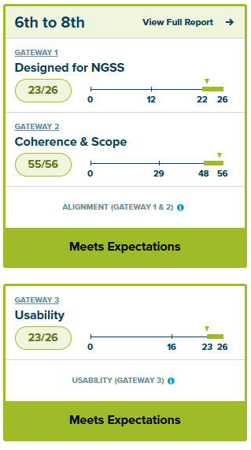
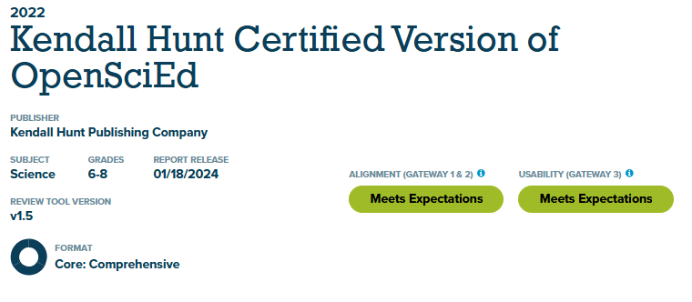
Open Sci Ed via Kendall Hunt Publishing

Slide 43
Open Sci Ed via Kendall Hunt Publishing
Other Middle School Curricula
NOT RATED OR POORLY RATED: Of the 14 middle school science curricula reviewed by EdReports, only two have received the 'green' rating.
DESIGNED FOR OUTDATED RESEARCH: Most middle school science programs do not embody the K-12 Framework for Science Education and NGSS standards.
Open Sci Ed Curriculum
HIGHLY RATED: OpenSciEd received a 'green' rating from EdReports, indicating the highest quality of science education instructional materials.
DESIGNED FOR THE K-12 FRAMEWORK FOR SCIENCE EDUCATION: The entire program was written for Framework-based standards like the NGSS.

Slide 44
Open Sci Ed via Kendall Hunt Publishing
Other Middle School Curricula
ORGANIZED FOR LEARNING ABOUT: Science learning is organized to make sense to someone who already knows the information.
TEACHER-DIRECTED: Programs use phenomena or demos as "hooks" to draw in students and experiments to reinforce learning.
Open Sci Ed Curriculum
ORGANIZED FOR FIGURING OUT: Science learning revolves around figuring out an intriguing phenomenon.
TEACHER FACILITATED: Phenomena generate the student questions, explanations, and ideas for investigations that motivate learning.

Slide 45
Open Sci Ed via Kendall Hunt Publishing
Other Middle School Curricula
LECTURE-BASED LESSONS: Teachers or books tell students about science.
CONFIRMATORY: Students are exposed to vocabulary and facts and follow the directions to confirm what they have learned.
Open Sci Ed Curriculum
COLLABORATIVE: Students work together and learn from each other as they ask questions, design investigations, and find solutions.
INVESTIGATIVE: Students investigate their questions as they build and revise their understanding of the science.

Slide 46
Open Sci Ed via Kendall Hunt Publishing
Other Middle School Curricula
SOME STUDENTS: Leads to a few students who think that science is relevant to their lives and even fewer that connect it to their future careers.
DIFFICULT TO ADAPT: Materials are locked in proprietary formats that make it difficult to adapt.
Open Sci Ed Curriculum
ALL STUDENTS: Instructional routines are designed to value every student's voice, fostering a sense of belonging and empowerment.
EASILY EDITABLE: Materials are provided in editable formats that allow teachers to adapt.

Slide 47
Open Sci Ed via Kendall Hunt Publishing
Some direct quotations from the Committee:
More relatable phenomena
Rigorous lessons and presentation of content
The lessons promote scientific discourse
Students are afforded opportunities to collectively apply the three dimensions as they try to makes sense of focus phenomenon
Embedded supports for ELL, 504/IEP available online in Spanish
Formative assessment available in every lesson – choose when to use
Sequential: spirals within the grade level and from one grade level to another
Routine evaluation of phenomena for engagement
Good long-term progression
Discussion routines are embedded and repeated
Tasks identified spoke to incorporation of the three dimensions – affording teachers the opportunity to glean student progress towards mastery of content

Slide 48
Open Sci Ed via Kendall Hunt Publishing
Some direct quotations from the Committee:
UDL and ELL is kept in mind throughout the units
The lesson story plans were very much a planned progression
This was very well done. They are using scenarios that are very accessible. They are equitable.
Students are engaged with building models. Every investigation requires that they use prior knowledge to do this.
Excellent professional learning space online.
Tona of assessments for each lesson.
Multilingual learner support, real-time scaffolding
Very authentic
This was more rigorous than other examples
The CCC’s are used in the framing of tasks and are aligned with the overall performance expectations of the unit/lesson.

Slide 49
What does it cost?
Student Materials – $54 per student edition ~ $78,840
– Class Kits vary by unit ~ $103,132
Teacher Materials – $114 per teacher edition ~ $5,700
Additional Costs – Shipping ~ $30,028
– Professional Development ~ $18,000
Total ~ $235,700
Note: Student Workbooks can be purchased for an additional $121,075 (including shipping).
Printing in district is recommended for significant savings.

Slide 50


August Facilities Update
Presented By: Mr. Edwin Vasquez
Manager of facilities and grounds
August 13, 2025

Slide 51

District Facility Maintenance & Custodial Services Updates
Thorough cleaning and disinfecting occurs daily for all of our touch points in the building (examples include but are not limited to door handles, bathrooms, entrances, exits, and handrails)
Walk-throughs of all district school facilities
Meetings between the District and PCI are held regularly based on updates
Facility projects continue so we can ensure a safe and clean learning environment for our children and staff.

Slide 52
Facilities Department Update
We have kicked off our summer cleaning! This means we are diving into cleaning and disinfecting all the classroom and office furniture, washing and waxing the floors, and giving the light fixtures and walls a good wipe down. It’s all about making our buildings ready for the start of a new school year for our dedicated staff and amazing scholars.

Slide 53
District Facilities Summer Project Updates
Summer Painting – we will brighten up our restrooms, stairwells, and hallways with fresh paint, and giving our classrooms some touch-ups too!
Replacement of the old steam boilers at Oakwood Avenue Community School.
The installation of the new digital marquees is still in progress, and we are currently running electricity to the panels.
The playground renovations have been completed at Central Elementary School. We are currently working on the renovations at Lincoln Avenue School.

Slide 54
District Facilities Summer Project Updates
The District ESIP project continues as we upgrade our lights to LED. We are currently working at Orange High School and Orange Preparatory Academy of Inquiry and Innovation.
Window Replacement at the Administration building is completed
We continue to addres workorders that are in Facilitron works.

Slide 55
Faclilites Department Updates
The following slides will showcase some of the work being done.

Slide 56
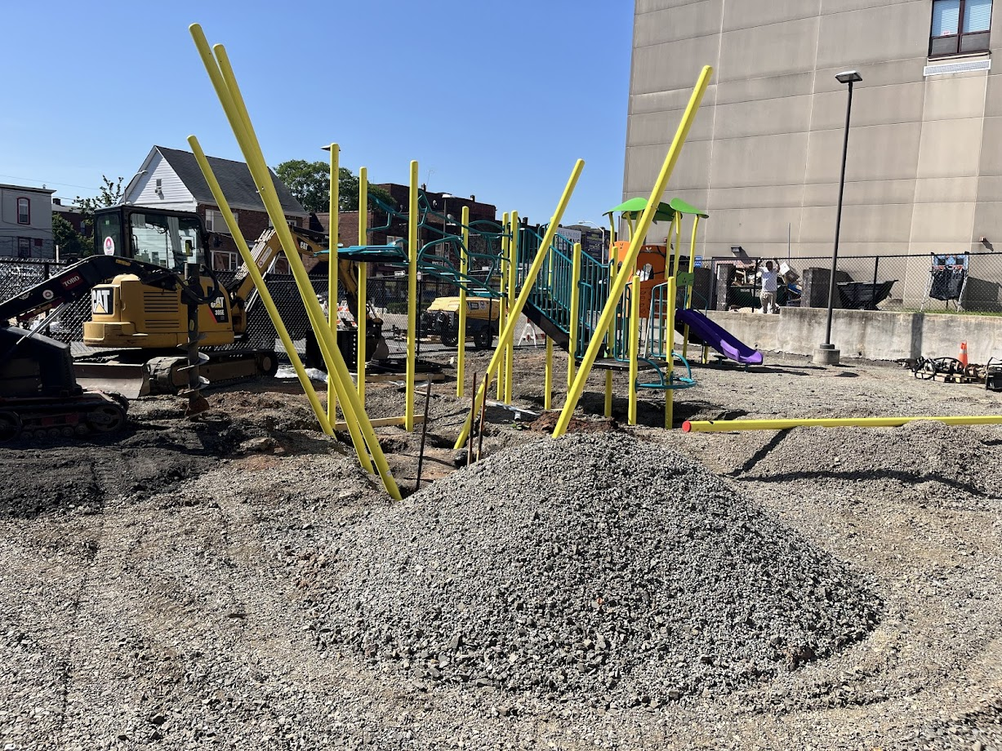
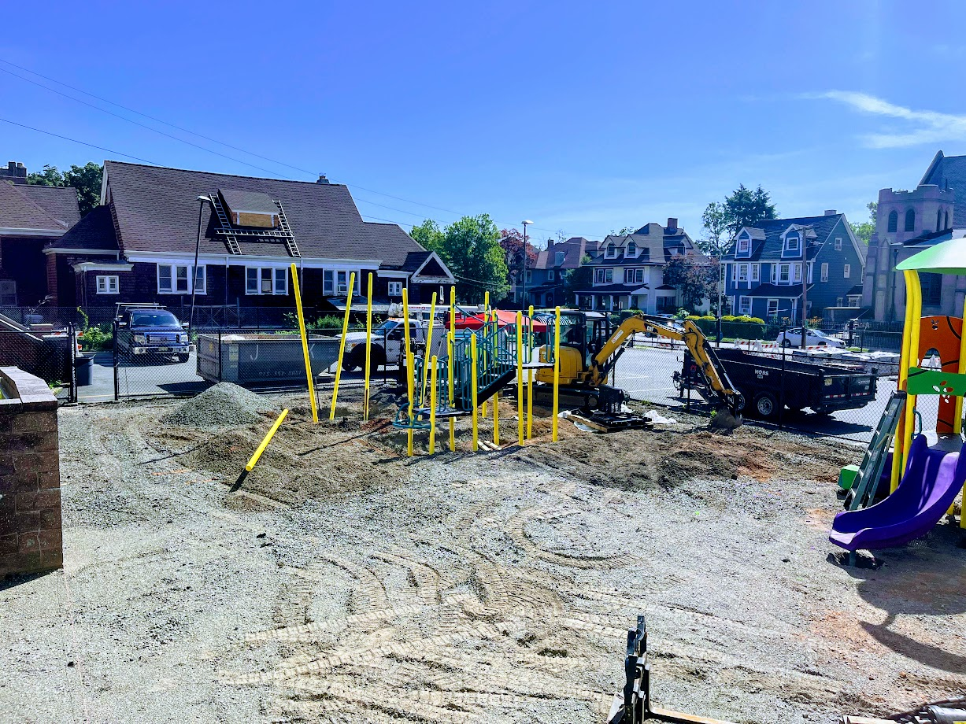
Facilities Department
Central Elementary School Playground Replacement.

Slide 57
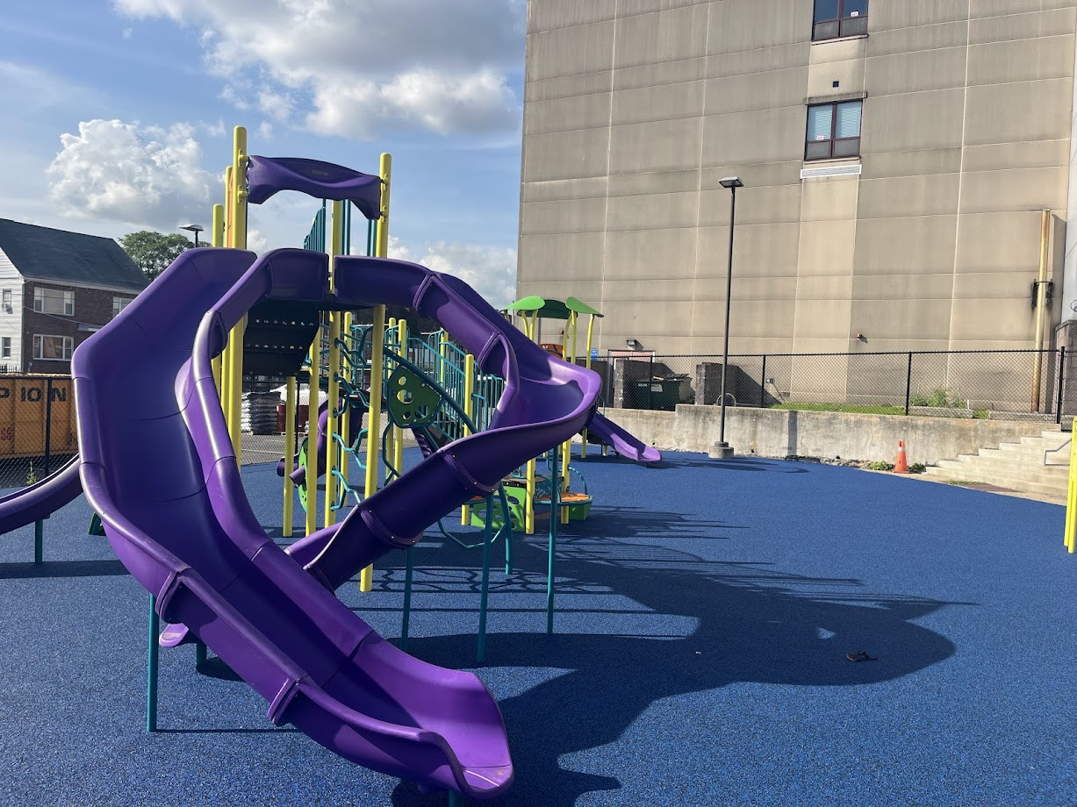
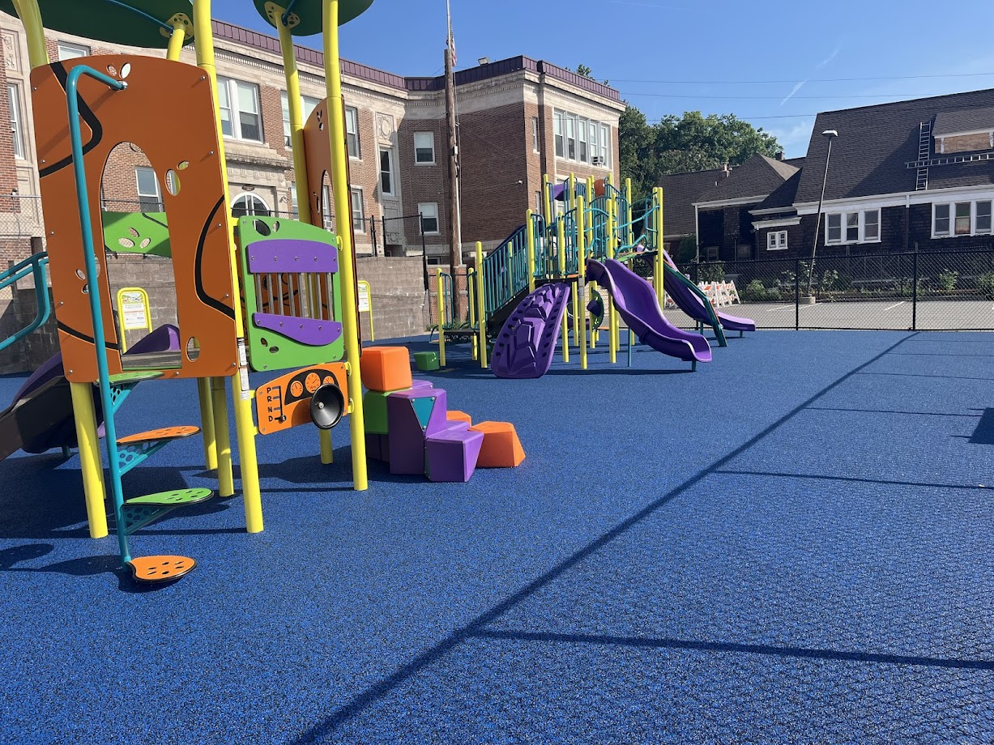
Facilities Department
Central Elementary School Playground Replacement

Slide 58
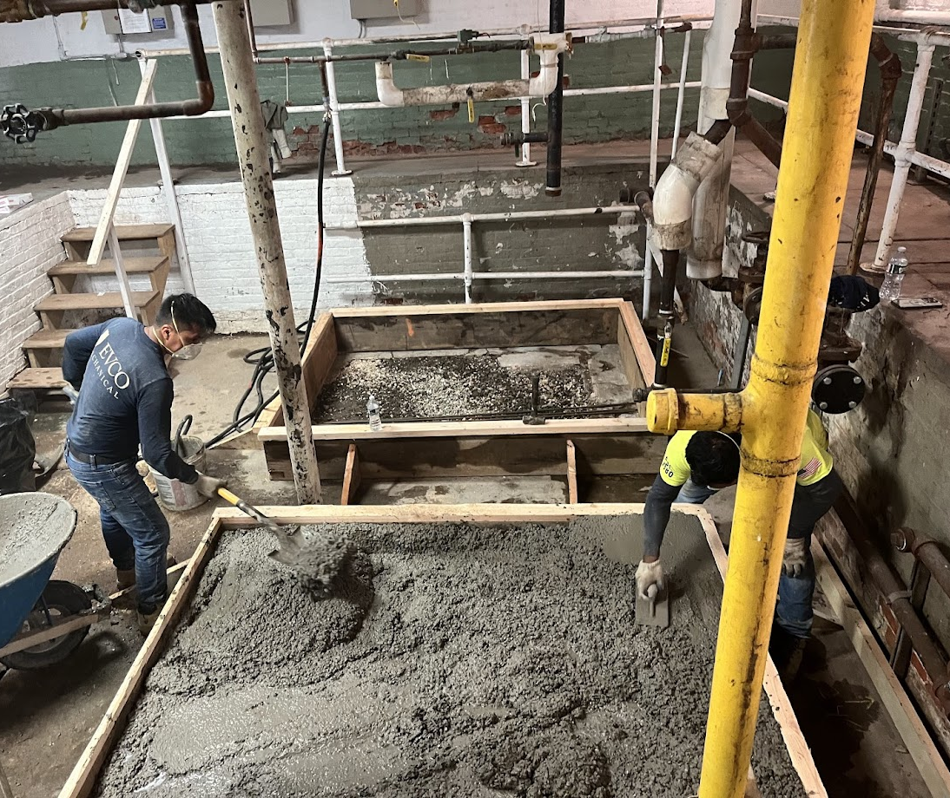
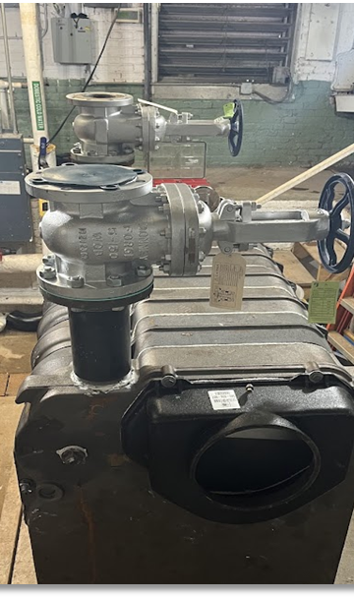
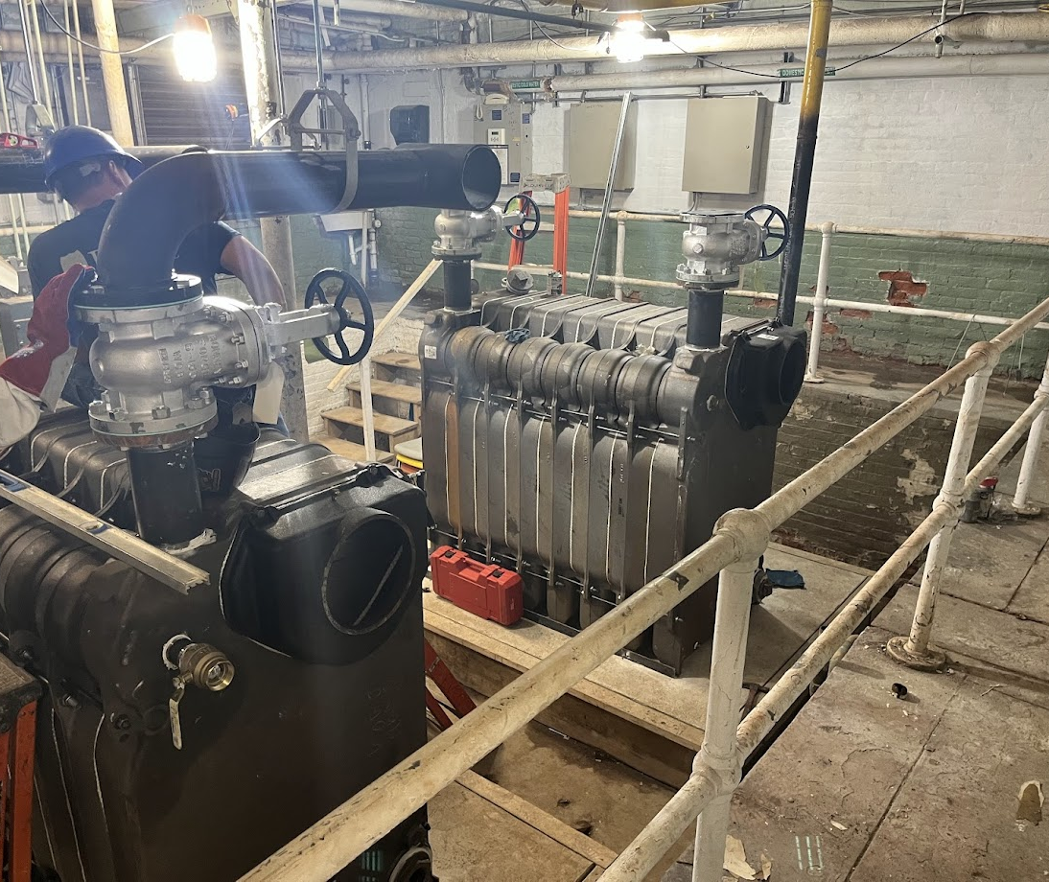
Facilities Department
Oakwood Avenue Community School Boiler Replacement

Slide 59
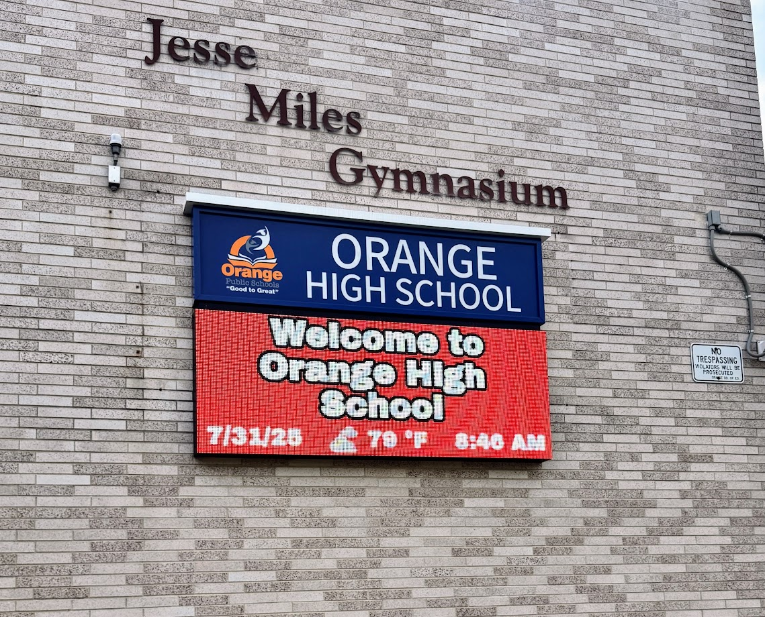
Facilities Department
New Digital Marquee

Slide 60
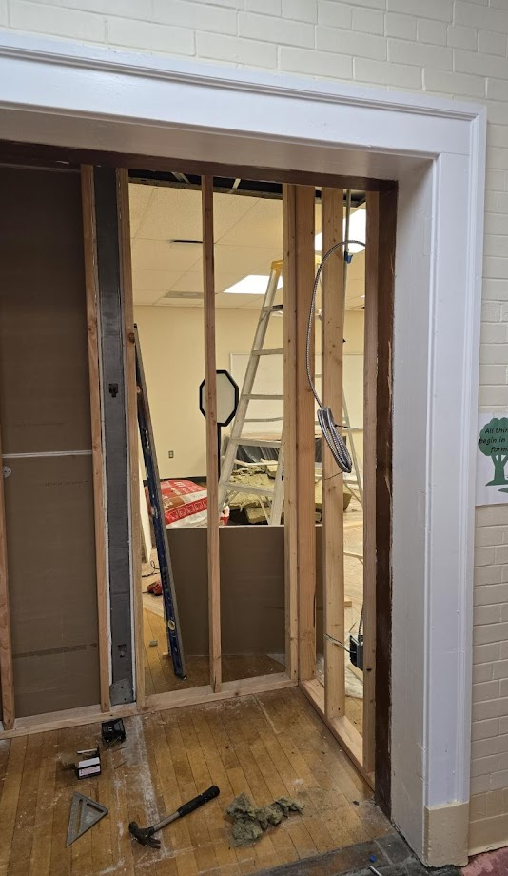
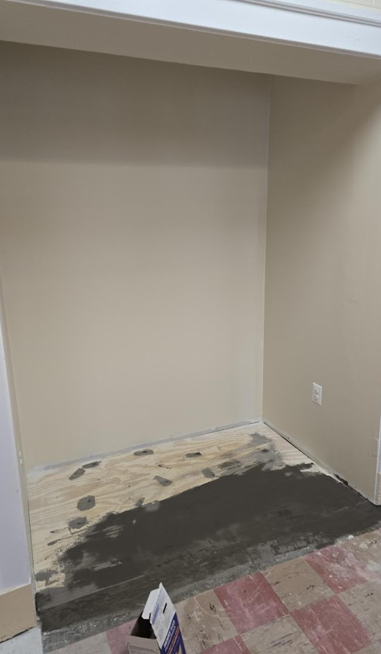
Facilities Department
Work continues at the Forest Annex.
Painting is completed
Classroom furniture is being delivered
Constructed a space for the Security Officer to be stationed

Slide 61
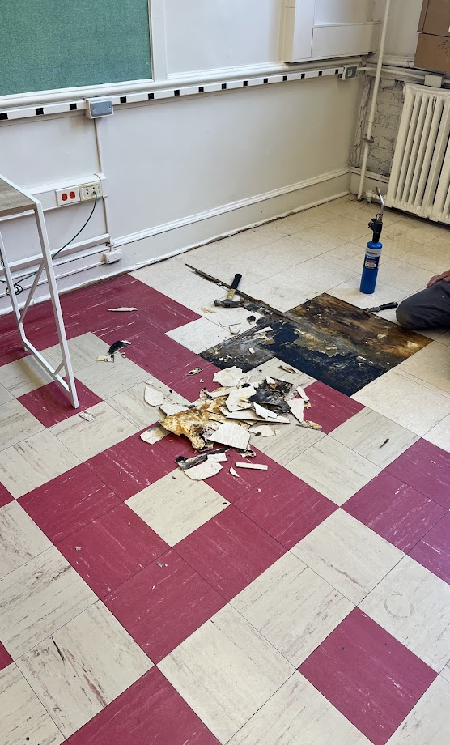
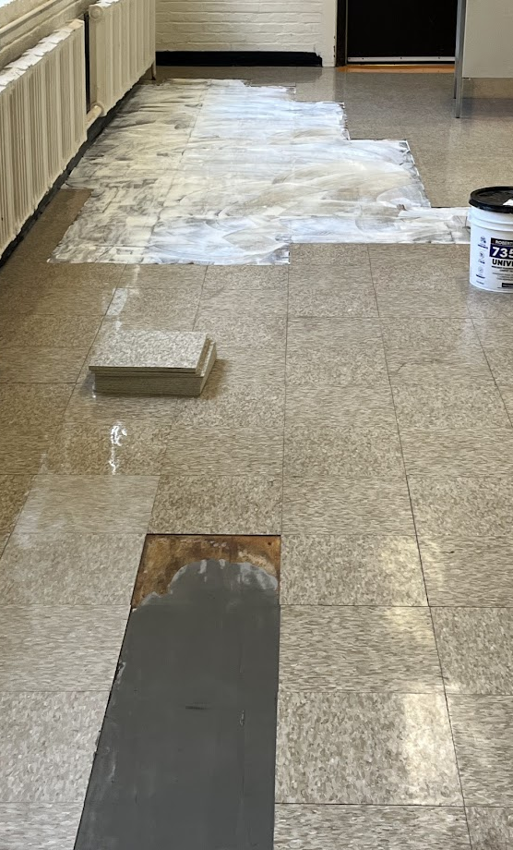
Facilities Department
We are addressing work orders, such as replacing damaged floor tiles.

Slide 62
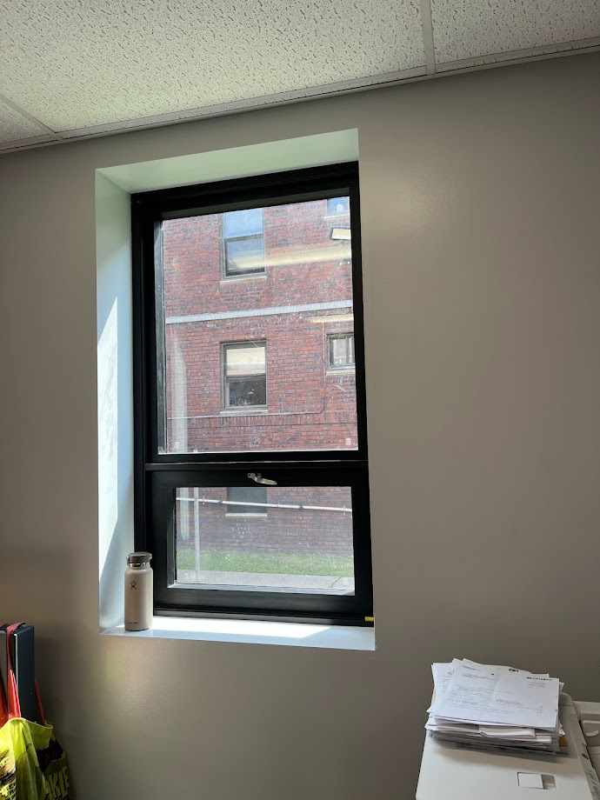
Facilities Department
Window replacement at the Administration building.

Slide 63
In the Month of September 2025
The team and I, under the direction of Mr. Ballard, will continue to meet with the Schools Development Authority and Terminal Construction to make sure that there is progress related to the punch-list items for construction at Orange High School and the Cleveland Street School Projects.

Slide 64
Reminder from the Office of Facilities
We will continue to update the community, staff, and Board of Education members of all progress.
The health and safety of staff and students are at the apex of all facilities undertakings.

Slide 65
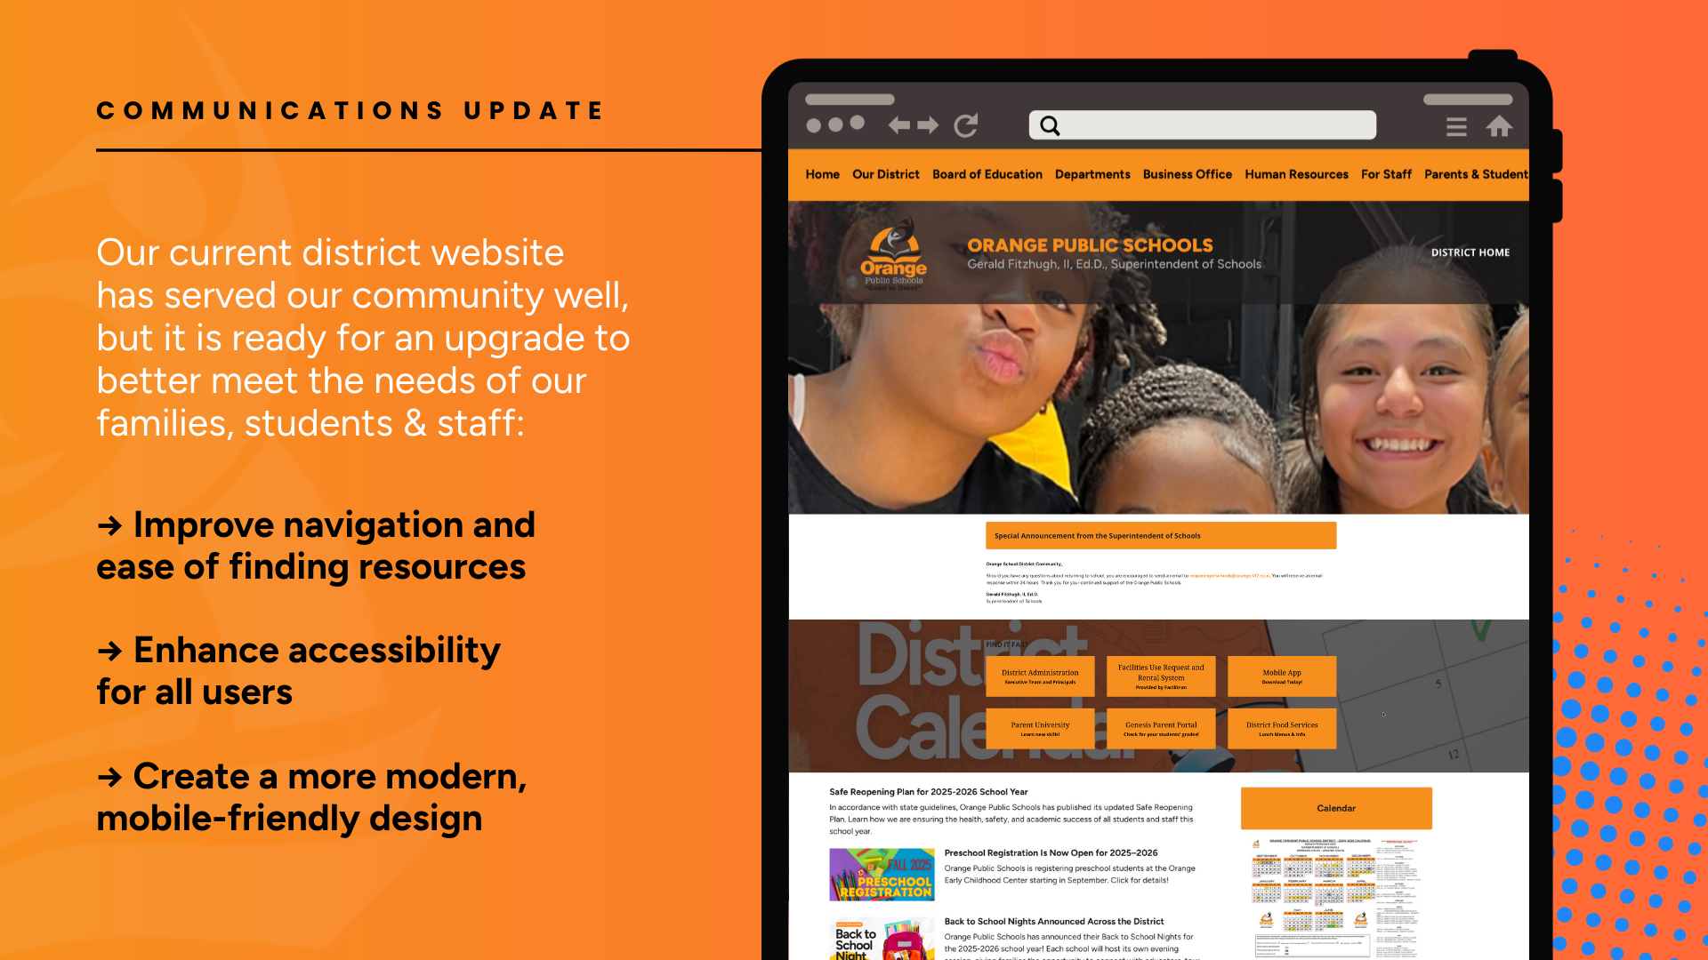

Slide 66
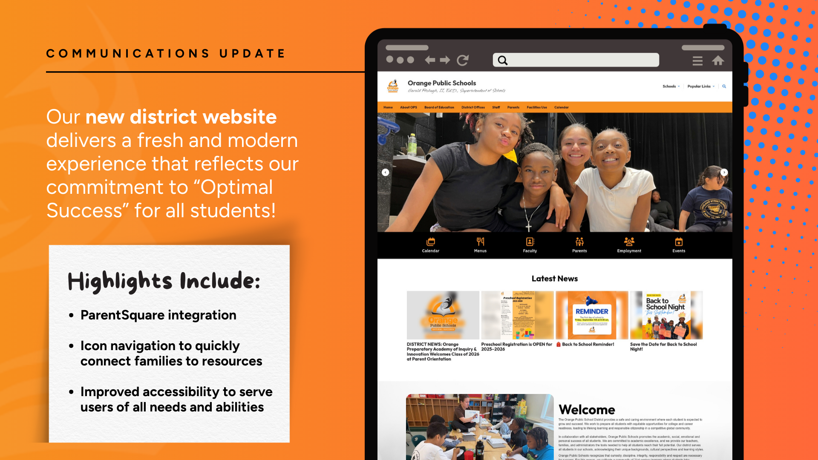

Slide 67

Verizon VILS

Slide 68


FYI
SUPPLY LISTS ARE NOW ACTIVE ON ALL SCHOOL WEBSITES!

Slide 69
Orange Public Schools Social Media
Social Media Hashtags: #OptimalSuccess
#MovingintoGreatness #OrangeStrong
Follow us:
Orange Public School District
@ops_district
opsdistrict
Orange Public School District

